Slide 1
Presentation
to
National Assembly Standing Committee on S&T
on
December 19, 2014
Pakistan Council of Renewable Energy Technologies (PCRET)

Slide 2
PCRET
Established on 8th May, 2001
By merging
NIST
National Institute of Silicon Technology
(Established in 1981)
&
PCAT
Pakistan Council of Appropriate Technology (Established in 1974)
Notes:
PCRET
2

Slide 3
MISSION STATEMENT
Committed to research, develop, promote, disseminate, impart training, and create Renewable Energy culture.

Slide 4
Head office : Islamabad
Regional Offices:
i). Quetta
ii). Peshawar
iii). Karachi
iv). Lahore

Slide 5
Key Functions
To establish facilities, expertise and to conduct research for suitable renewable energy technologies,
To produce materials, devices and applications in the field of renewable energy,
To promote renewable energy technologies in the country, through PSDPs and pilot scale productions
To organize conferences, seminars, workshops for promotion of technologies and products, and,
To establish national/provincial and international linkage in the field of renewable energy technologies.

Slide 6
Budget Non- Development (Last Five Years)
( Rs. Million)
Year | Demand | Allocation | Utilization | R & D
2009-10 | 91.000 | 58.000 | 55.423 | 0.300
2010-11 | 107.850 | 69.490 | 58.458 | 3.790
2011-12 | 97.625 | 91.331 | 84.457 | 14.716
2012-13 | 117.038 | 91.330 | 91.330 | 8.503
2013-14 | 151.195 | 82.034 | 79.8976 | 9.400
2014-15 | 151.783 | 82.000 | 41.450 (till Dec.2014) | 5.000

Slide 7
Budget Development (Last Five Years)
( Rs. Million)
Year | Allocation | Release | Utilization
2009-10 | 175.426 | 138.981 | 138.981
2010-11 | 133.963 | 84.076 | 84.076
2011-12 | 102.527 | 77.969 | 77.969
2012-13 | 121.168 | 90.156 | 87.937
2013-14 | 88.012 | 88.012 | 88.012
2014-15 | 31.654 | 6.331 | 6.331

Slide 8
PCRET Regular Manpower Status

Slide 9
Renewable Energy Technologies at PCRET
Photovoltaics (PV)
Solar Thermal
Microhydro Power (MHP)
Biogas
Wind Energy

Slide 10
Photovoltaics (PV)

Slide 11
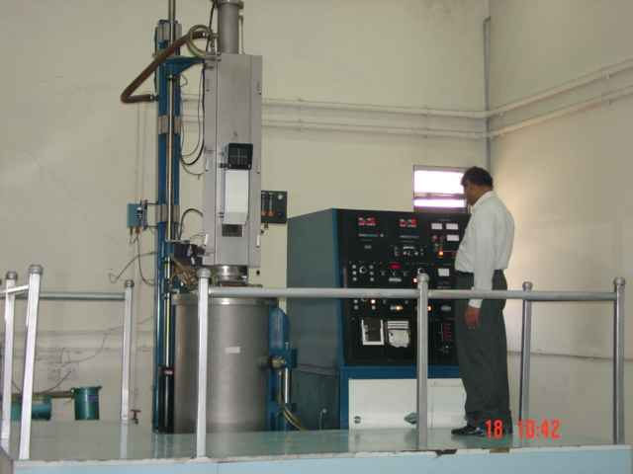
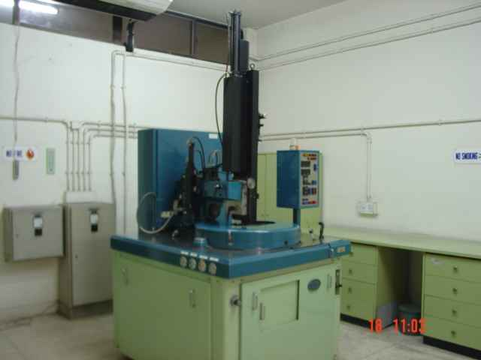
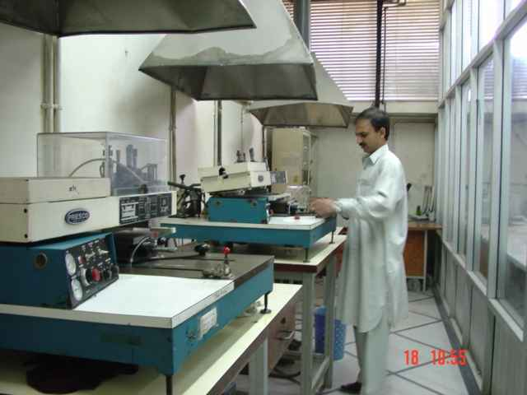
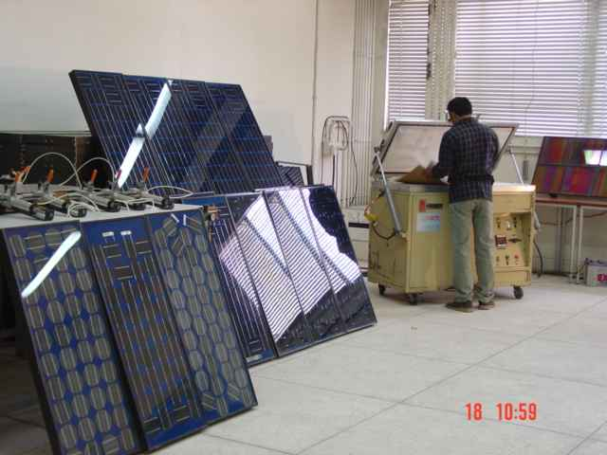
PV Research Laboratories (old)
Crystal Growth
Wafering
Cell Process
Lamination

Slide 12
PSDP Projects of PV
Project#1: Testing Laboratory for Photovoltaic (PV) and Solar Thermal Appliances
Project Cost : Rs. 21.00 Million
Project Starting Date : Dec, 2004
Project Completion Date : Dec, 2007
Project #2. Up Gradation of Facilities to Produce Silicon Solar Cells and Modules up to 80 kW Annual Capacity
Project Cost : Rs. 418.498 Million
Project Starting Date : 01.01.2007
Project Completion Date : 30th June, 2014
Project #3. Up Gradation and Extension of PCRET Facilities at Islamabad Center
Project Cost: : Rs. 418.736 Million (original)
Rs. 276.304 Million (Revised)
Project Starting Date : October, 2007
Project Completion Date : Expected (30th June, 2015)

Slide 13
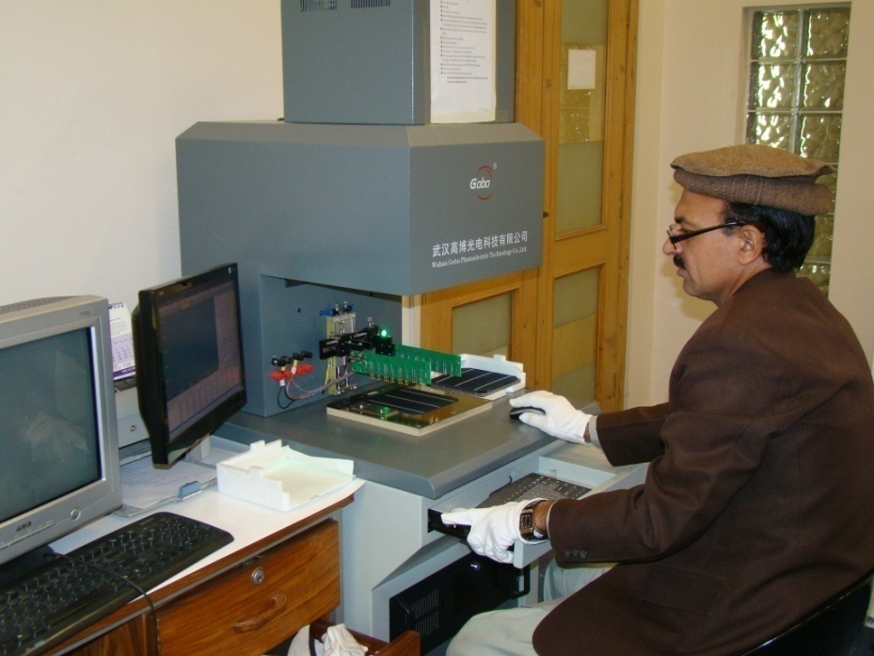
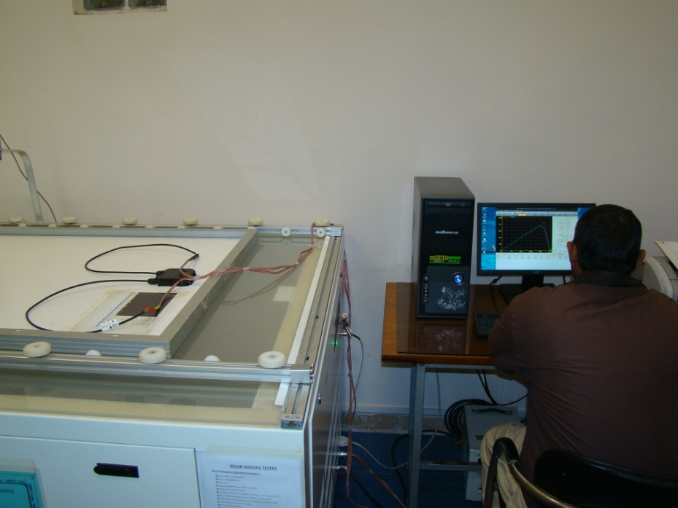
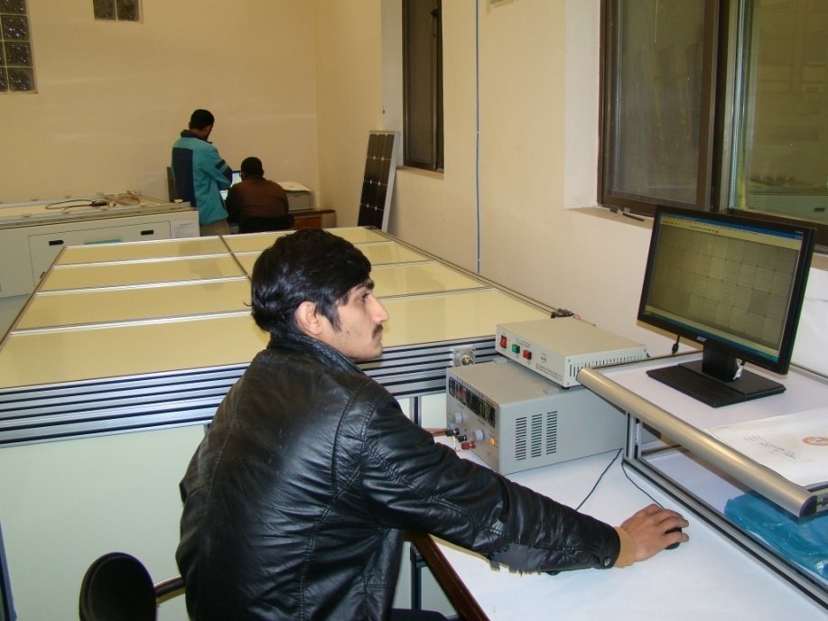
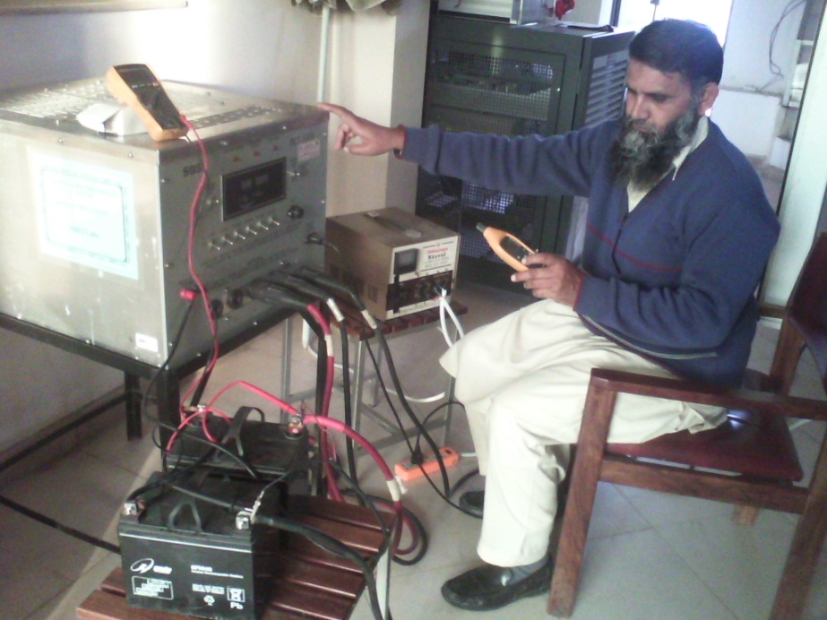
Testing Lab for PV and Solar Thermal Appliances

Slide 14
Testing Lab for PV and Solar Thermal Appliances

Slide 15
Testing Lab for PV and Solar Thermal Appliances
Standard: ISO/IEC-17025 (under process)
PV Cell Testing
PV Module Testing
PV Module Electro Luminescence Testing
Solar Flat Plate Geyser Testing
Solar Evacuated Tube Geyser Testing
Solar Inverter Testing
Solar Charge Controller Testing
LED Lights Testing
Battery Testing
Battery Electrolyte (Specific Gravity) Testing

Slide 16
Testing Lab for PV and Solar Thermal Appliances
Companies/NGO’s/GO’s to which PCRET has Provided Testing Services
S.No. Organization Testing Service Provided
1. M/s PV Silicon Technologies, Lahore PV Module Testing
2. M/s Tesla Industries Ltd. Islamabad PV Module Testing
3. M/s Ace Quality Plus, Pvt. Ltd., Rawalpindi Solar Geyser Testing
4. M/s Solaratics, F-8, Islamabad PV Module Testing
5. M/s MAHASA PAKISTAN, Saddar, Rawalpindi PV Module Testing
6. M/s 752 CTE C/O HQ 494 FWO, Karachi PV Module Testing
7. M/s Directorate of Alternative Energy, Energy Solar Energy
Department, Government of Sindh, Karachi Components/Products Testing ( i.e. PV Module,
Solar Inverter, Solar
Charge Controller,
Batteries, LED Lights

Slide 17
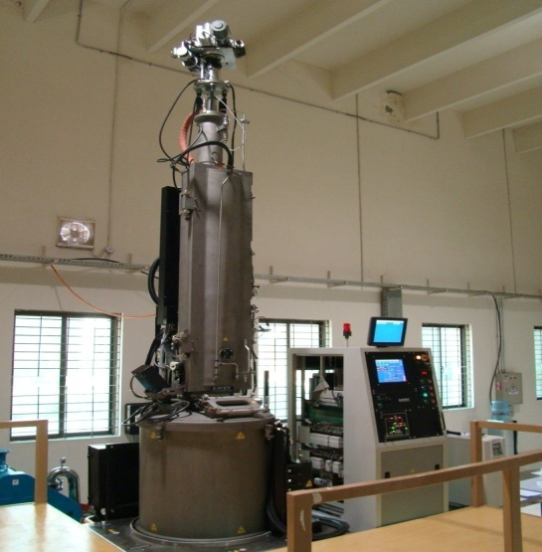
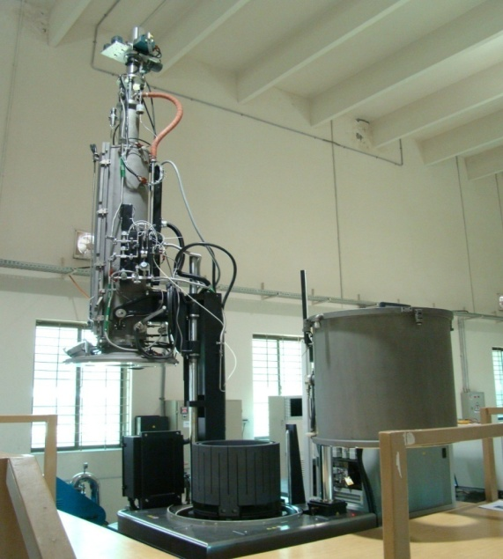
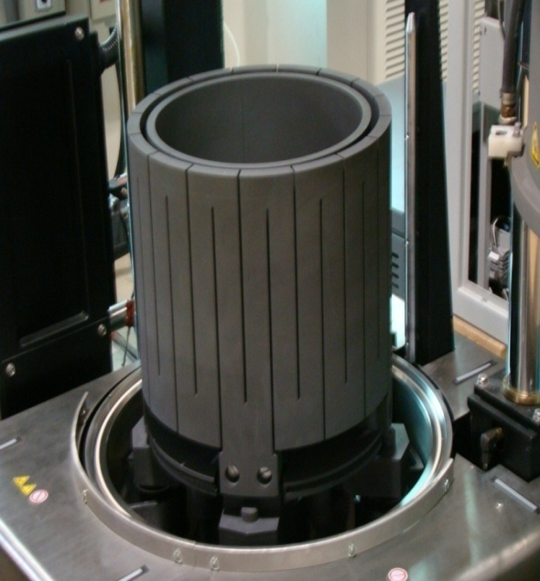
PV Research Laboratories (new)
Crystal Growth
Notes:
17

Slide 18
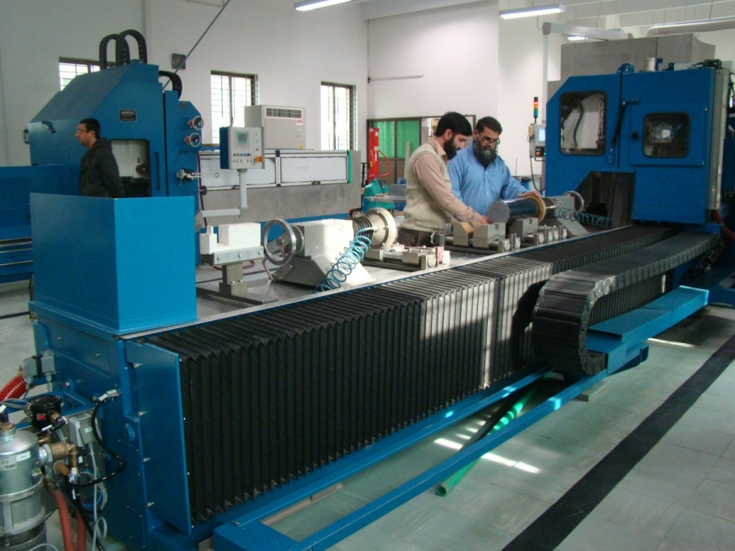
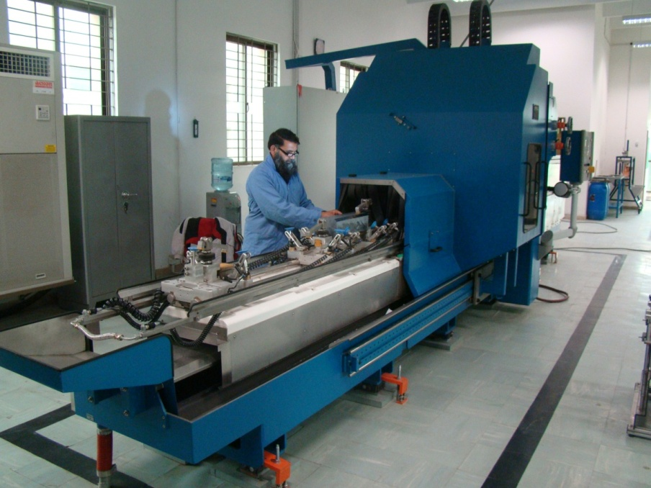
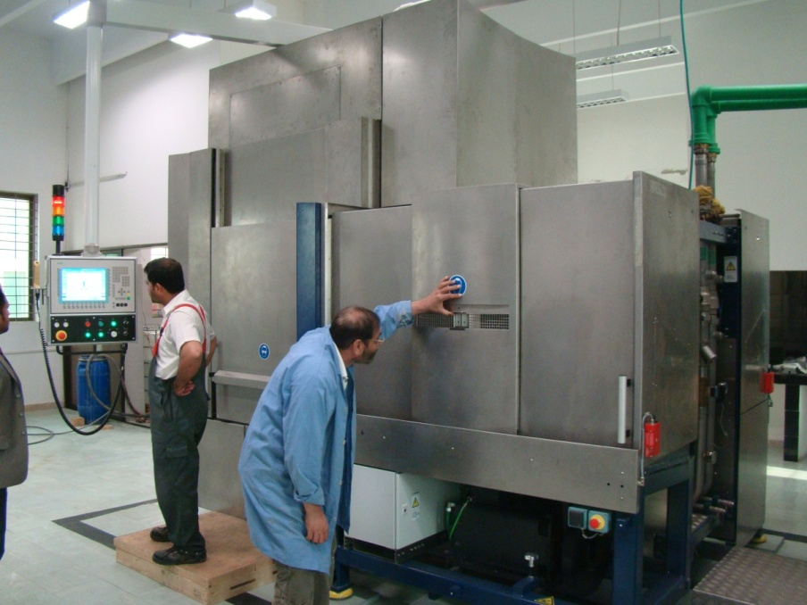
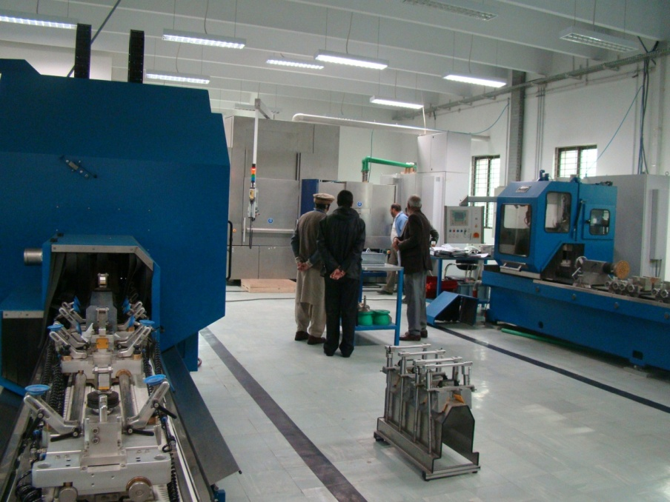
PV Research Laboratories (new)
Wafering
Notes:
Three issues in chater 2 and three chpters discussing the isses repectively.

Slide 19
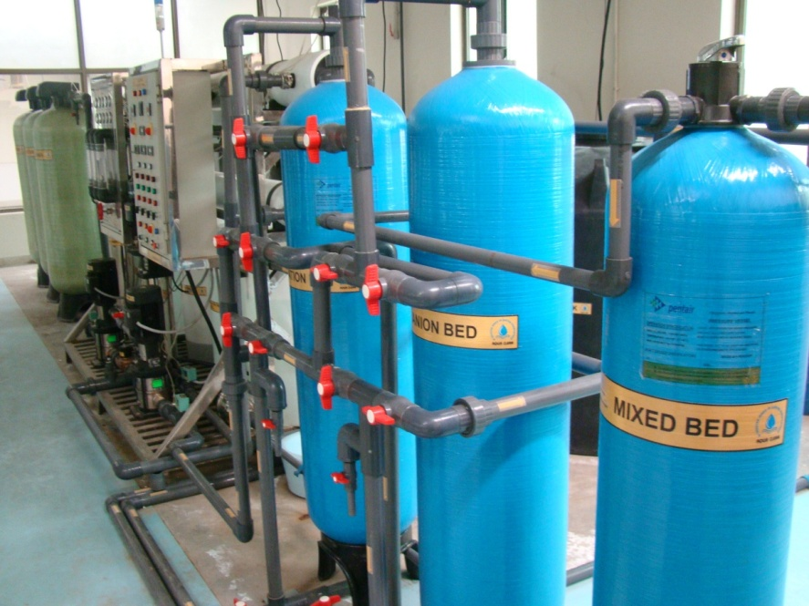
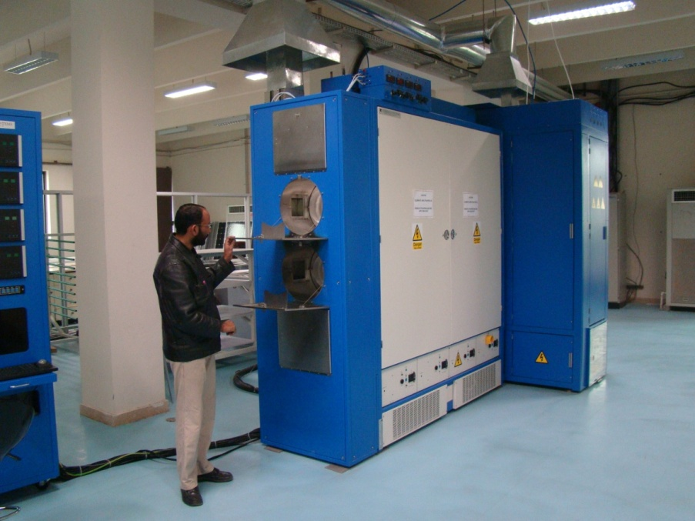
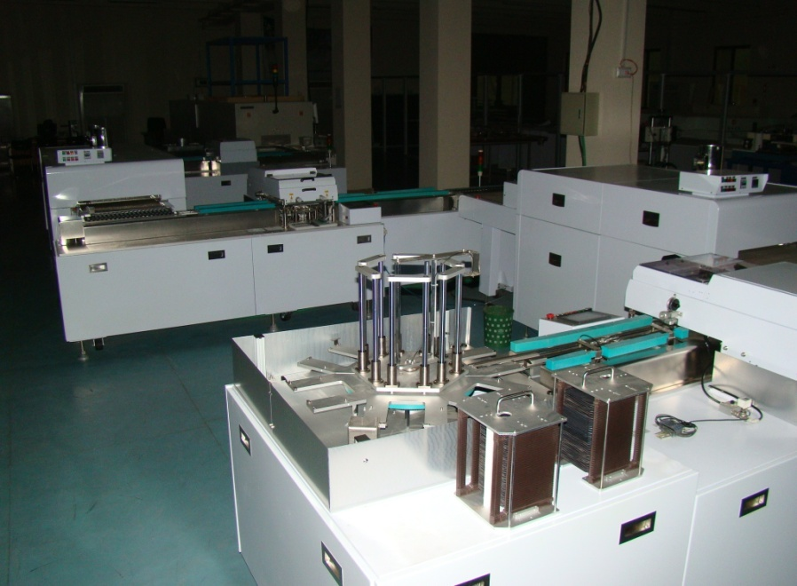
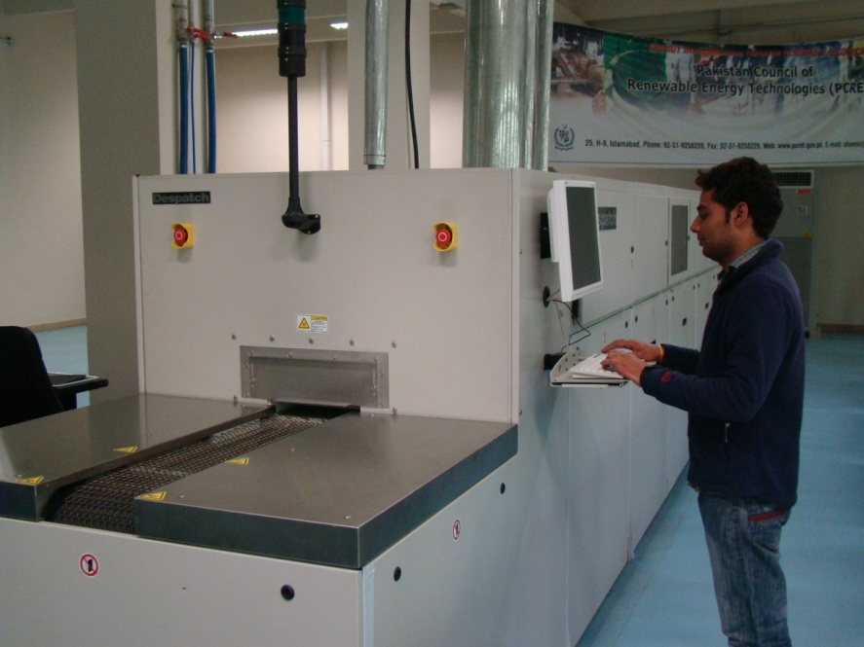
PV Research Laboratories (new)
Cell Process
Notes:
Three issues in chater 2 and three chpters discussing the isses repectively.

Slide 20
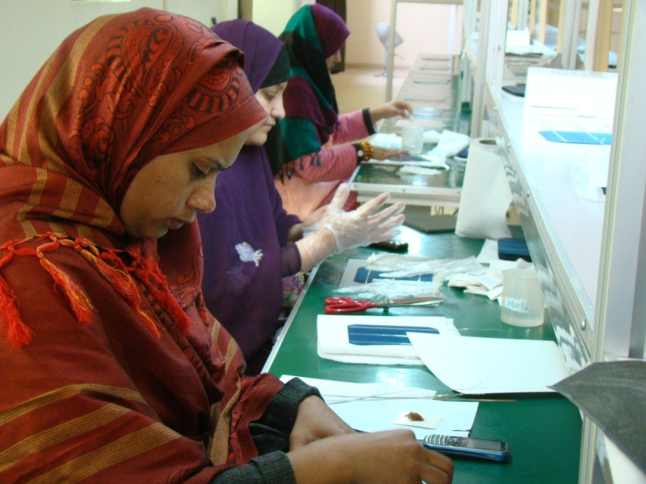
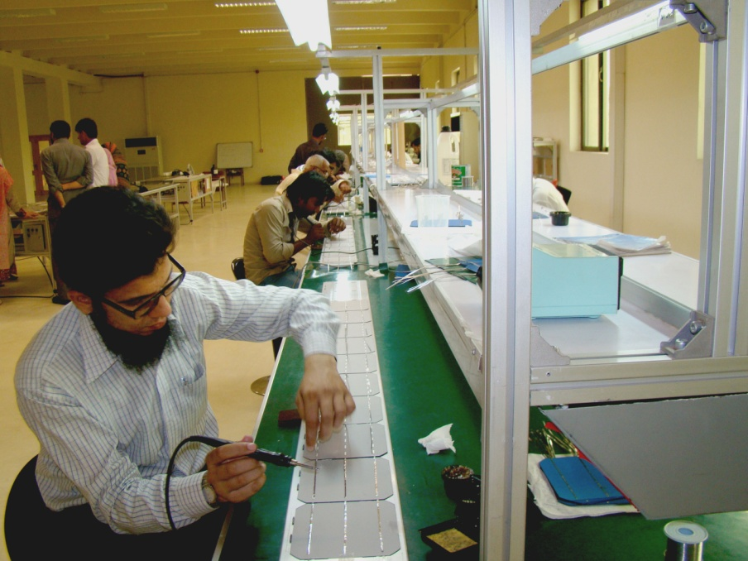
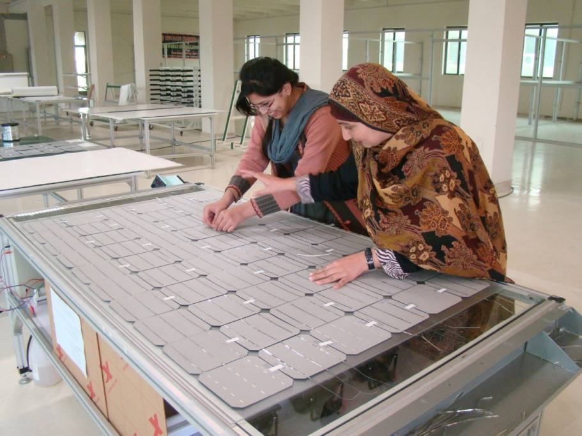
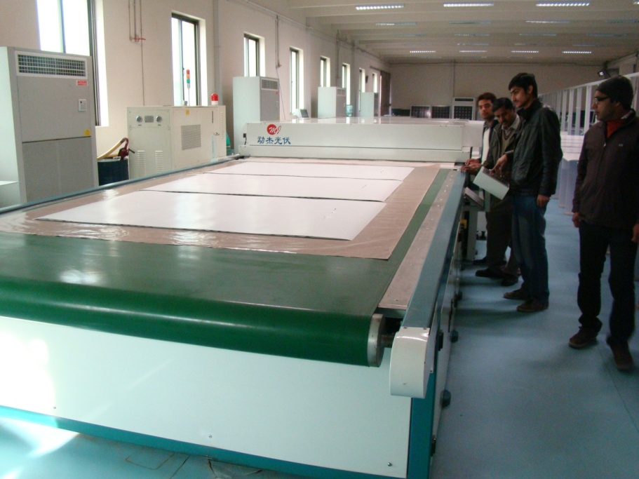
PV Research Laboratories (new)
Lamination
Notes:
Three issues in chater 2 and three chpters discussing the isses repectively.

Slide 21
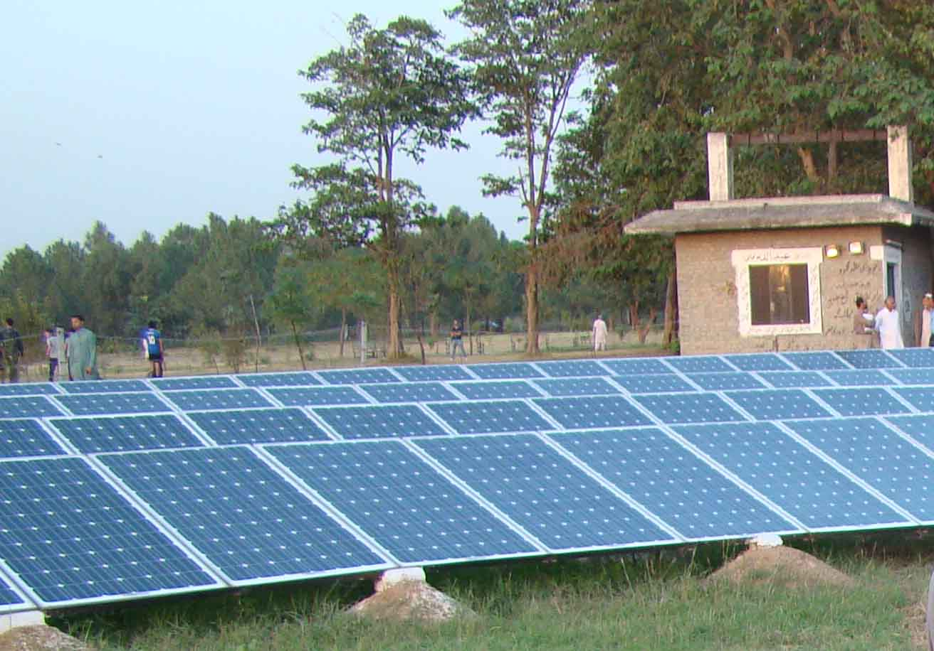
PV Installations by PCRET in Islamabad
CDA Tubewell No 208 electrified through Solar Power using PV modules fabricated at PCRET
Capacity : 35 kW
Depth of Water Level : 375 feet
Dia : 6 inches

Slide 22
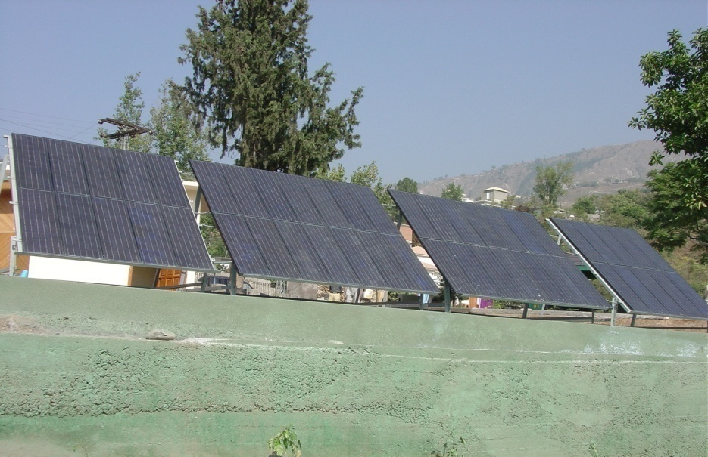
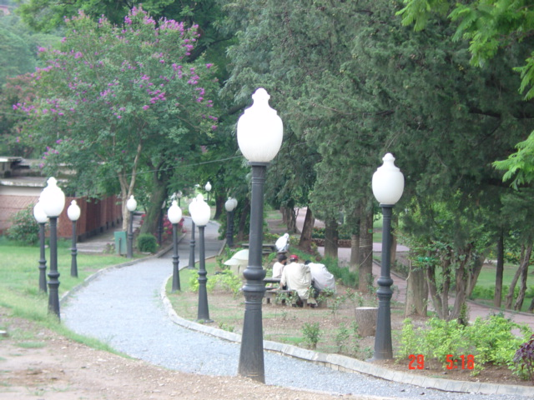
PV Installations by PCRET in AJK
Earthquake Area Muzaffarabad
Jalalabad Park, Muzaffarabad

Slide 23
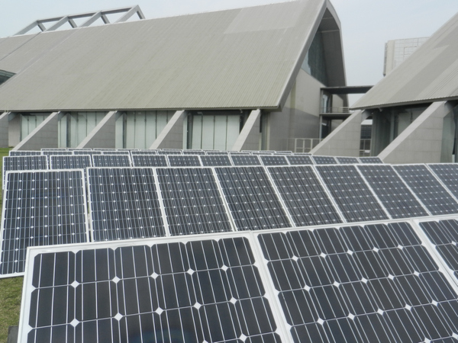
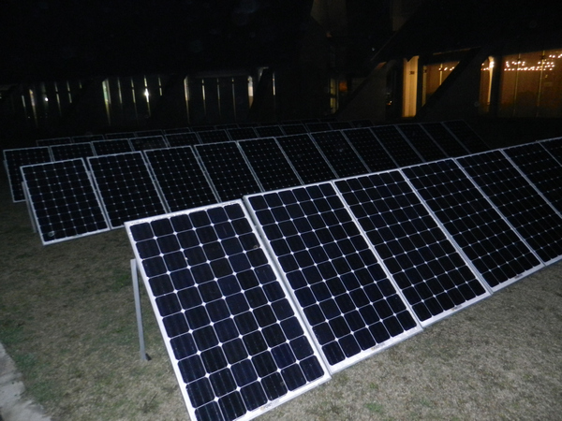
PV Installations by PCRET in Punjab
Expo Centre, Lahore ( Capacity : 25 kW)

Slide 24
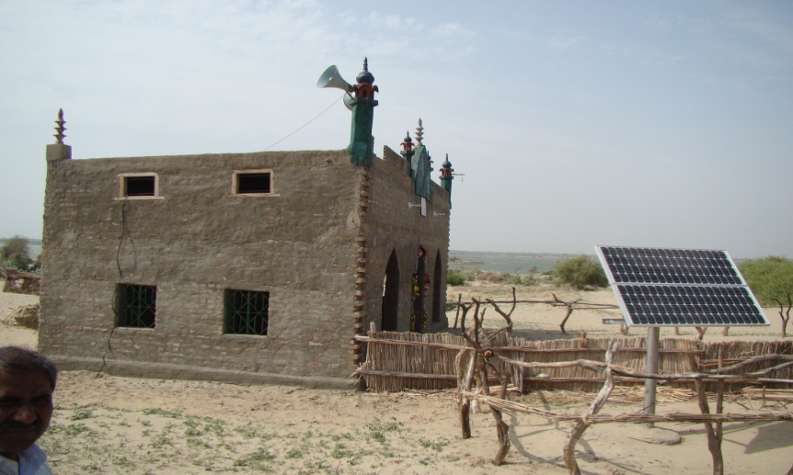
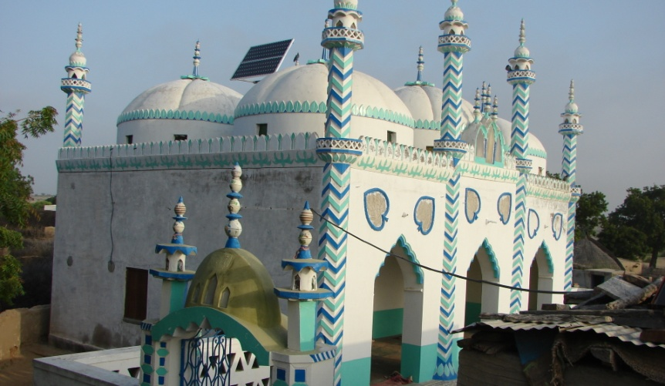
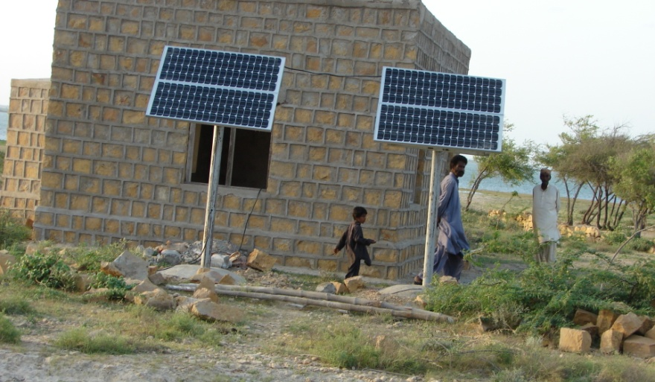
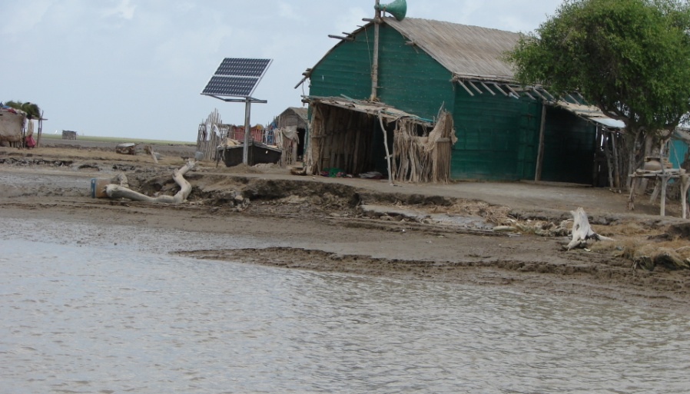
PV Installations by PCRET in Sindh
Padiaro, Sanghar
Tardos, Thar
Juman Moosa, Thatta
Bhoori, Keti Bunder

Slide 25
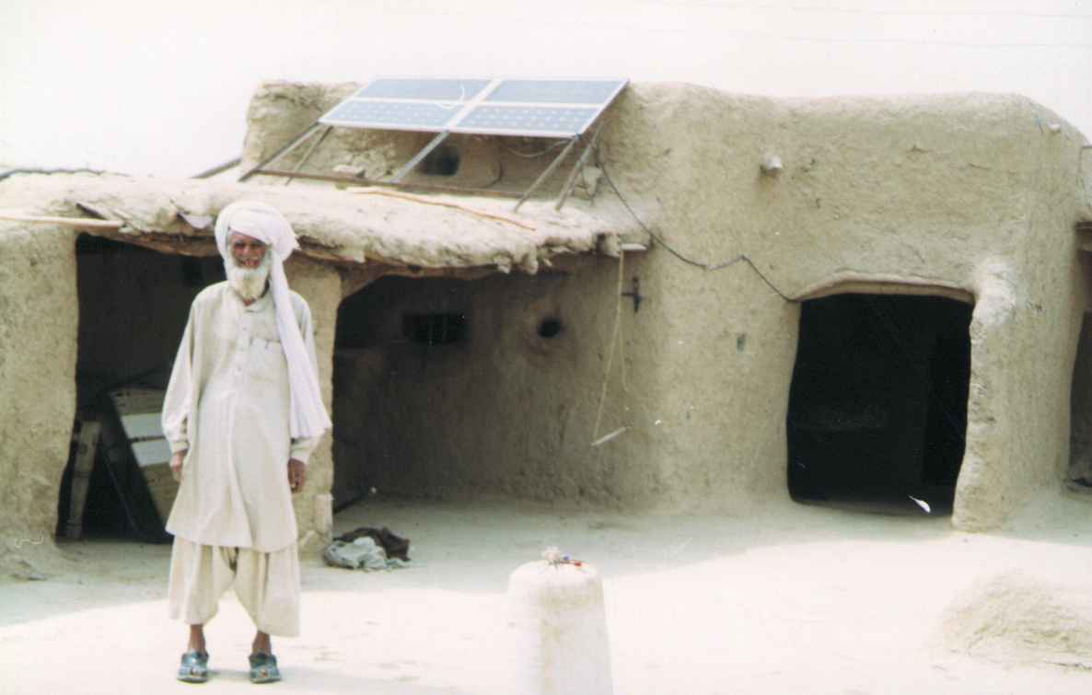
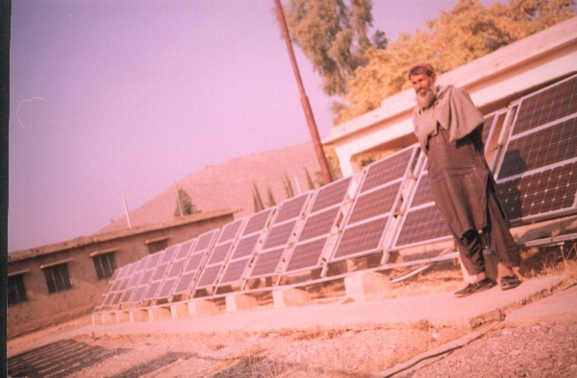
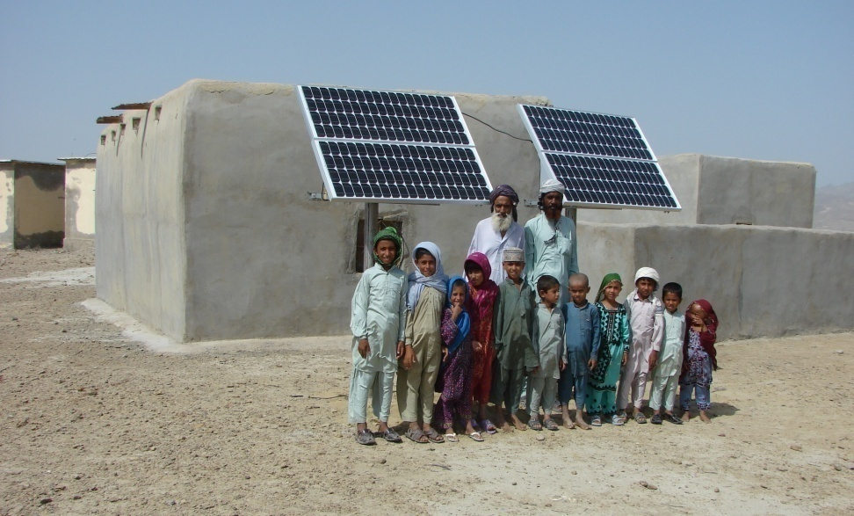
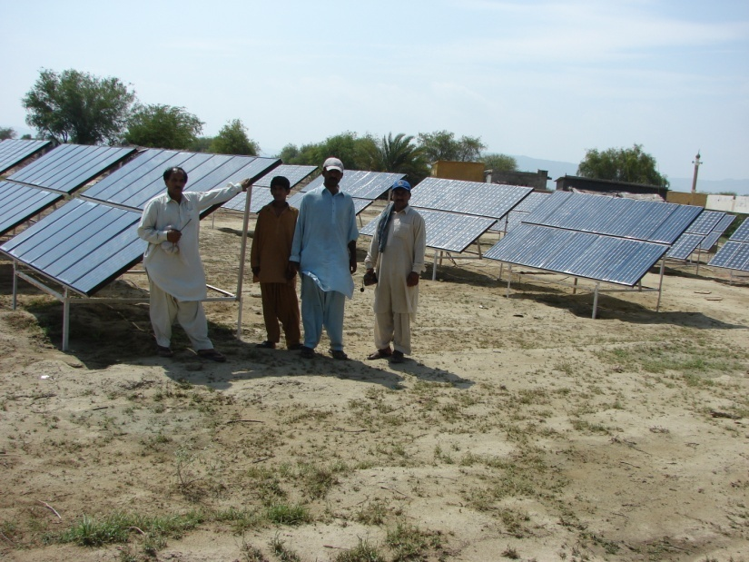
PV Installations by PCRET in Baluchistan
Loralai
Dera Bugti
Bachoo Goth, Lasbella
Hasan Goth, Lasbella

Slide 26
PV Installations by PCRET in Baluchistan
14 kW Capacity PV System for electrification of
50 houses at Khuzdar

Slide 27
PV Installations by PCRET
Installed 512 Solar PV systems with total capacity of 135 kW electrifying 500 houses, mosques, and schools for demonstration purposes since 2001.

Slide 28
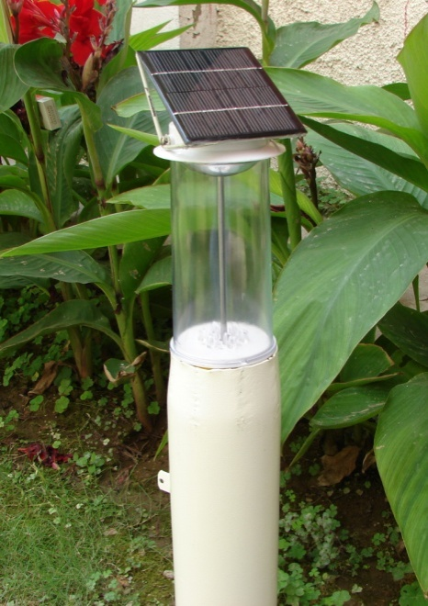
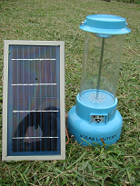
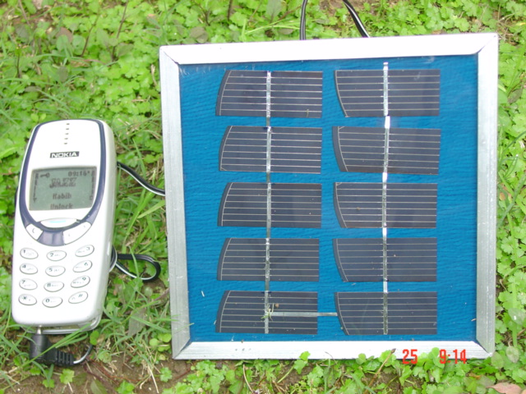
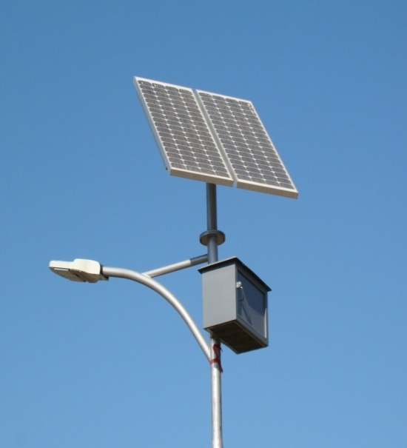
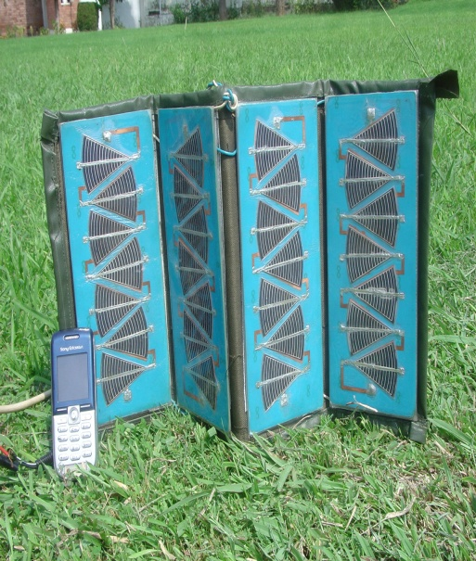
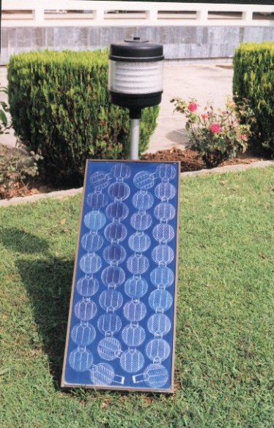
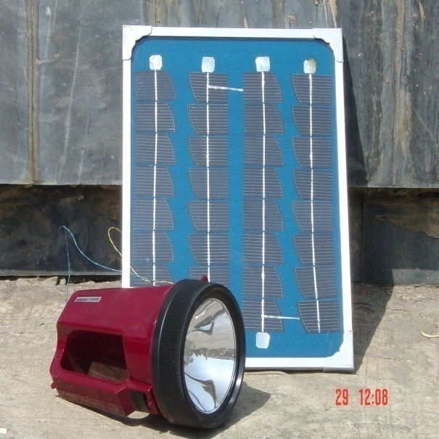
Other PV Products by PCRET

Slide 29
Submitted PSDP Projects (PV)
S/N | Project Name | Cost in Million Rs.
1 | Installation of 1000 Solar Tube Wells Throughout Pakistan | 2499.867
2 | Solar Solution for Homes and Offices for Meeting Energy Demands | 4490.000
3 | Green Public Buildings Project, Islamabad | 613.200

Slide 30
PV Industry Established in Private Sector (technical know-how provided by PCRET)
Akhter Solar Pvt. Ltd. Hattar
Tesla Solar Pvt. Ltd. Islamabad
Solar Green Pvt. Ltd. Lahore
Siachin Solar Pvt. Ltd. Karachi
SWO – Solarization Welfare Organization, Karachi
AWARE Office, Chachro, Therparker

Slide 31
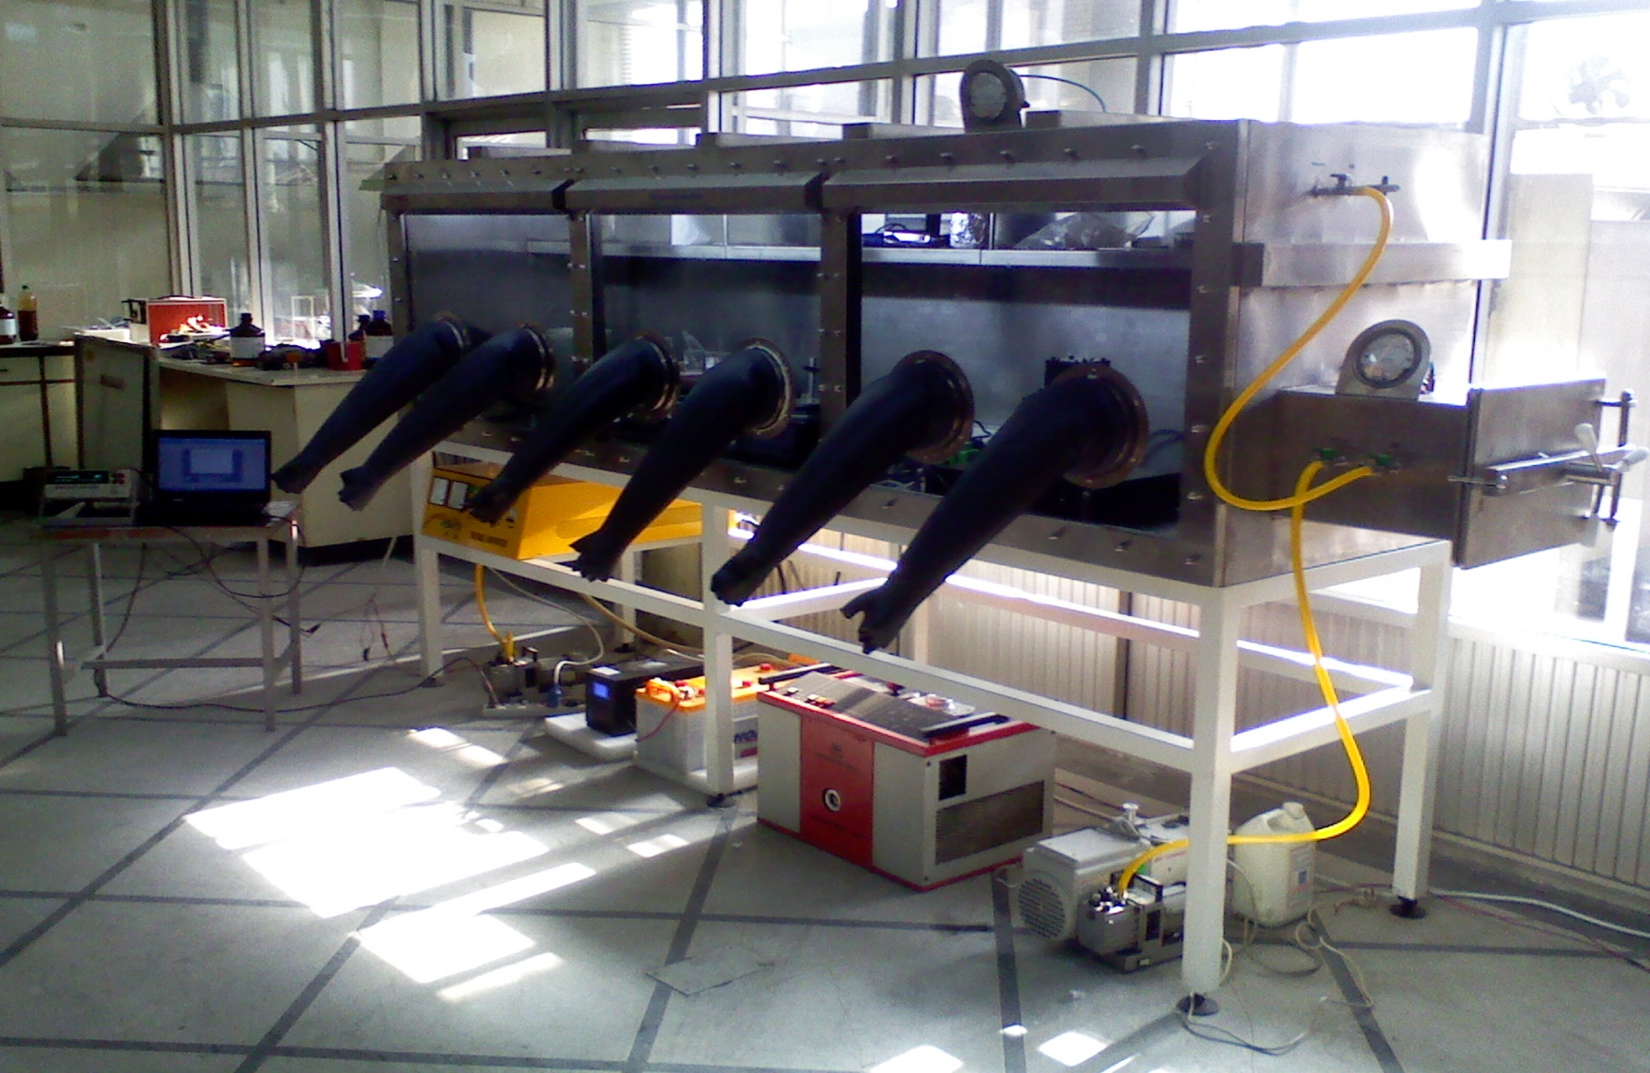
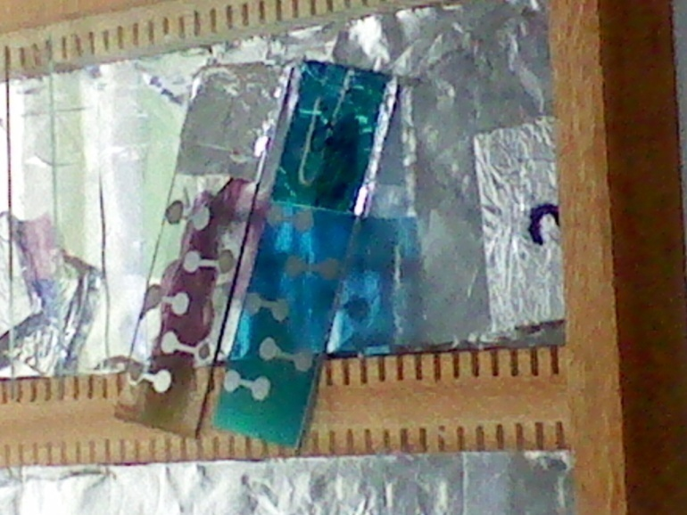
Advanced PV Lab at PCRET
Newly Established Innovation Incubator for Advanced Photovoltaics
at PCRET Head Office, Islamabad.
Notes:
Three issues in chater 2 and three chpters discussing the isses repectively.

Slide 32
Publications in 2014
Authored book:
A book (Charge Transport in Hybrid Organic Semiconductor
Structures (Introduction, Basics, Methods and Models) written
by PCRET Expert (Dr.Azfal Hussain).
Impact factor Journal Publications in 2014:
“Fabrication and Characterization of CuPc/PCBM based Organic Solar Cells with Metal Interlayer”, Muhammad Ahsan Naveed, A. Hussain, K. Islam, P. Akhter, JIARM (Ref. No. 18182, Accepted) (IMPACT FACTOR OF JIARM – 1.625).
2. “Simple and Inexpensive Electrodeposited Silver/ Polyaniline Composite Counter Electrodes for Dye-sensitized Solar Cells”, Sheeba Ghani, Rehana Sharif, Ayesha Ashraf, N. Zafar, Azhar A. Zaidi, Shamaila Shahzadi, Afzal H. Kamboh, “Journal of Material Science” Accepted, DOI 10.1007/s10853-014-8708-z (IF- 2.3).
“Influence of fullerene derivative replacement with TiO₂ nanoparticles in organic bulk heterojunction solar cells” M. Ikram, S. Ali, R. Murray, A. Hussain, Islah-u-din, S. Ismat Shah, Current Applied Physics, Vol.15 (2015) p. 48-54 (IF- 1.78)
“Hybrid Organic Solar Cells using both ZnO and PCBM as Electron Acceptor Materials”, Muhammad Ikram, Roy Murray, Afzal Hussain, Salamat Ali, Ismat Shah, Materials Science and Engineering B, 189 (2014) 64-69. (IF-1.78).
Journal Publications in 2014:
“Effect of mixing ZnO:TiO2 Nanoparticles in P3HT :PCBM Solar cells” S. Ali, A. Zareen, M. Ikram, R. Murray, A. Hussain, S. Ismat Shah, European Scientific Journal, Special Edition/ Vol. 2 (2014), p. 457-461.

Slide 33
Research Collaborations
Dr. Qiquan Qiao, Centre for advanced Photovoltaics, South Dakota State University, USA.
Prof. Dr. Ismat Shah, Mat. Science & Eng./ Physics &Astronomy, University of Delaware, USA.
Dr. Aamir Habib, SCME, NUST, Islamabad.
Dr. Nasir Hussain, SCME, NUST, Islamabad.
Dr. Zohair Khan, Centre for Energy Systems, NUST, Islamabad.
Dr. Pervez Akhter, Centre of Energy Systems, NUST, Islamabad.
Dr. Waqas Khalid, Dept. of Physics, CIIT, Islamabad.
Mr. Manzar Abass, Dept. of Physics, CIIT, Islamabad.
Dr. Ashfaq Ahmad, Dept. of Physics, CIIT, Lahore.
Dr. Aysha kamboh, Dept. of Physics, CIIT, Lahore.
Dr. Mujtaba Shah, Dept. of Chemistry, QAU, Islamabad.
Dr. Safeer Ahmed, Dept. of Chemistry, QAU, Islamabad.

Slide 34
Research Collaborations... contd
Prof. Dr. Aamir Saeed, Dept. of Chemistry, QAU, Islamabad.
Prof. Dr. Tasneem Zehra, Dept. of Physics, QAU, Islamabad.
Dr. Syed Zafar Illyas, Dept. of Physics, AIOU, Islamabad.
Dr. Hassan Sayyad, Faculty of Eng. Sci., GIK Institute of Engineering and Technology, Topi.
Dr. Yasir Joya, Faculty of Eng. Sci., GIK Institute of Engineering and Technology, Topi.
Dr. Jahan Akbar, Dept. of Physics, Hazara University, Mansehra.
Prof. Dr. Salamat Ali, Dept. of Physics, GC University, Lahore.
Dr. Abdul Waheed, Dept. of Physics, UET, Lahore.
Dr. Rehana Sharif, Dept. of Physics, UET, Lahore.
Dr. Fakhira Aziz, Jinnah College for Women, University of Peshawar.
(46 Ph.D/MS/UG students have completed their research projects using PCRET Labs)

Slide 35
Solar Thermal

Slide 36
Solar Thermal Products by PCRET
Solar Water Heater
Installed 25 solar dryers with total capacity of 5460 Kg/day fruit

Slide 37
Solar Thermal Industry Established in Private Sector
(technical know-how provided by PCRET)
Gold Roof, Hattar
Solar Geyser, Islamabad
Solar Line, Karachi
Orential Solar, Multan
Miltronix Pvt. Ltd, Islamabad
Super Soft Eng, Pvt. Ltd. Rawalpindi
Hard Bone Pvt. Ltd. Islamabad
Izhar Solar Pvt. Ltd., Lahore
EBR Pvt. Ltd. Lahore

Slide 38
Microhydro Power (MHP)

Slide 39
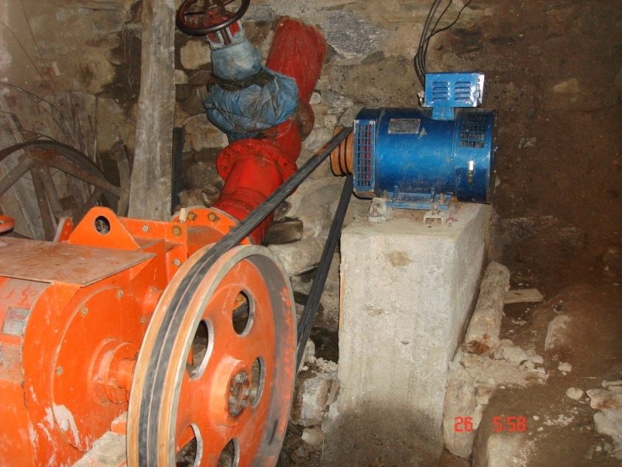
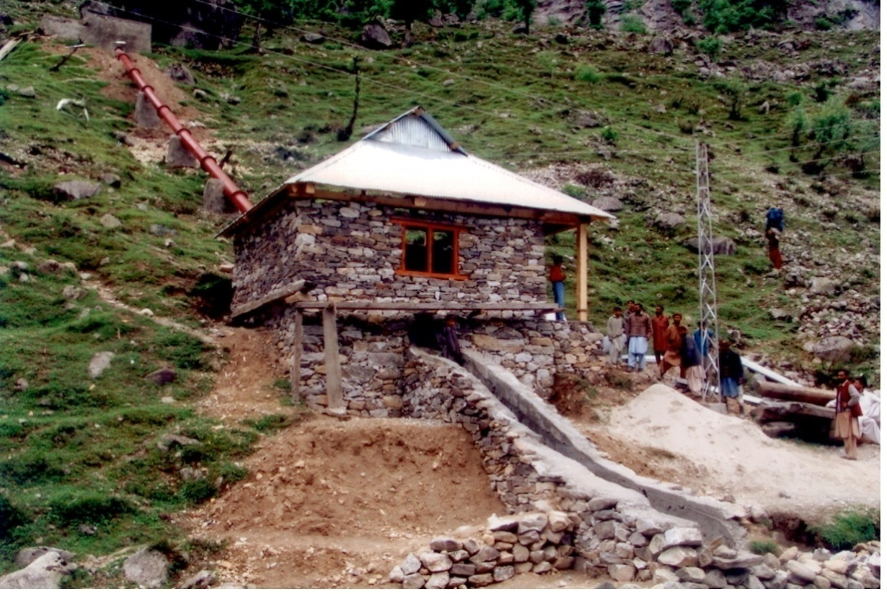
MHP Installations by PCRET
Microhydro Plants
Plants Installed : 562 Nos. (9.7 MW capacity)
House electrified : 80,000 Nos.
Cottage Industry : 200 Nos.

Slide 40
PSDP Projects of MHP
Recently Completed
Project : Provision of Electricity to Earthquake Effected Areas Through Installation of 100 Micro Hydro Power Plants.
Project Cost : Rs. 132.256 Million
Project Starting Date : July 2007
Project Completion Date : June, 2013

Slide 41
MHP Industry/NGOs Established in Private Sector
(technical know-how provided by PCRET)
Chitral Engineering Works, Texila
Mukhtiar Engineering Works,
Hydro Link , Islamabad
Chiragh Engg. Works, Mardan
Agha Khan Rural Support Program (AKRSP)
Sarhad Rural Support Program (SRSP)
National Rural Support Program (NRSP)
CRS Catholic Relief Services, Besham
PEACE, Hoti, Mardan

Slide 42
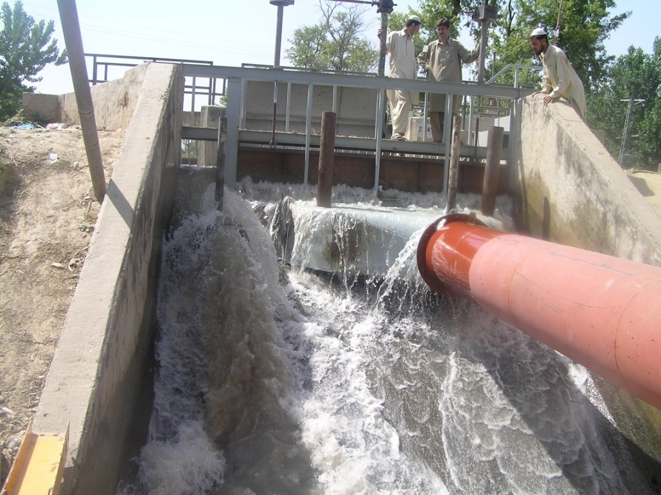
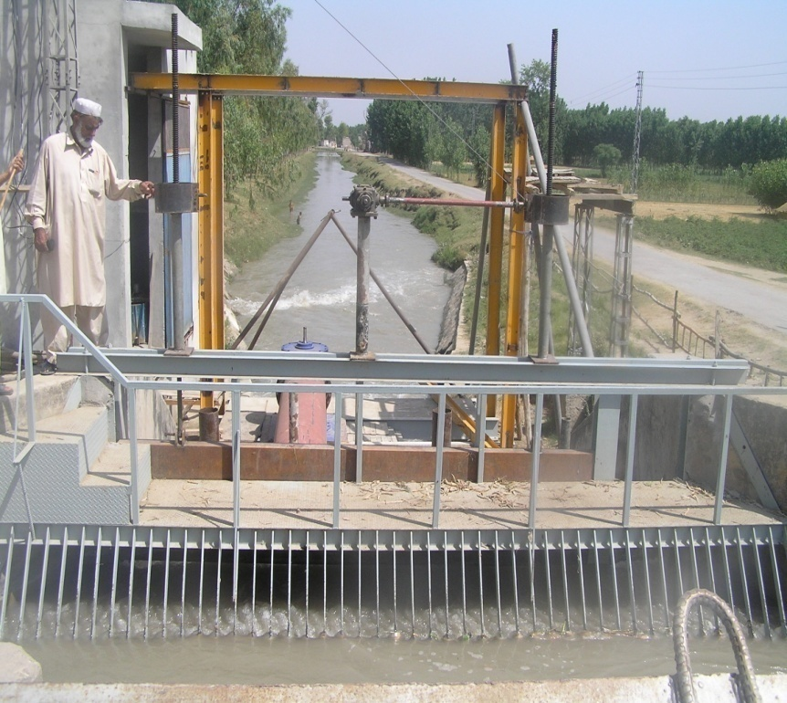
Canal Fall MHP Installed at Mardan
Systems Installed : 200 kW
Submitted Project
Development and Dissemination of Micro and Mini Hydro Power Plants in Public-Private Partnership
Rs.950.053 million

Slide 43
Biogas

Slide 44
Biogas Plants Developed by PCRET

Slide 45
Biogas Plants Developed by PCRET
Installed 4,016 Biogas Plants (size 3 & 5 m³/day: producing 18000 m³/day) and 200 cottage industries.

Slide 47
PSDP Projects of Biogas
Recently Completed Project : Development and Promotion of Biogas Technology for Meeting Domestic Fuel Needs of Rural Areas and Production of Bio-Fertilizer.
Project Cost : Rs. 97.648 Million
Duration : Five Year Project
Project Completion Date : June, 2013
Biogas Plants installed in the project : 2513
Submitted PSDP Project of Biogas
Installation of Biogas Plants, a substitute of Natural Gas and Chemical Fertilizer
Rs. 481.66 Million

Slide 48
Biogas Industry/NGOs Established in Private Sector
(technical know-how provided by PCRET)
National Rural Support Program (NRSP), Islamabad
Program Network (RSBN), Islamabad
Rural Support Program Network, Khushab
KOSHISH, Distt: Sialkot
Kissan Farmer Development, Khanewal.
Green Circle Organization (GCO), Khanewal
Social Welfare Community Development, Vehari
Pakistan Domestic biogas Program (PDBP)/Rural Support
Tameer Millat Welfare Trust, Muzaffargarh
Kissan Welfare Association, Bahawalpur
Bhit-Rural Sustainability Program (BRSP), Sehwan Sharif, Jam Shoro, Sindh.
Centre for Development studies ands Practices, Baluchistan.

Slide 49
Wind Energy

Slide 50
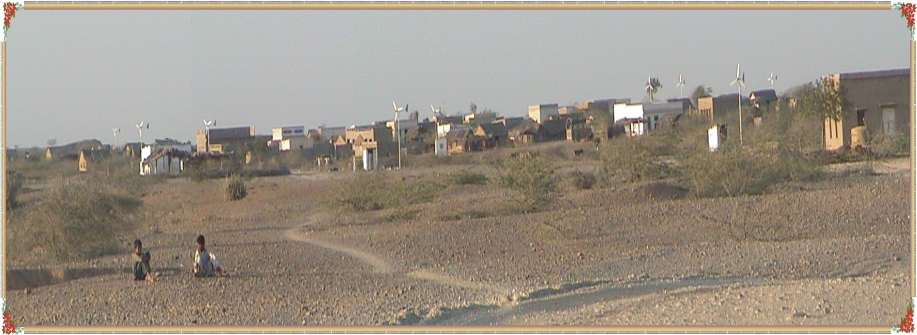
Windmills Installed by PCRET
A Panoramic View of Village Gul Muhammad,
Showing some of the Wind Turbines
installed by PCRET

Slide 51
Windmills Installed by PCRET
PCRET has installed (155 units; 161 kW net capacity) of small wind turbines (0.5 – 10 KW each) in Sindh and Balochistan electrifying 1560 houses and 9 costal guard check posts.

Slide 52
Status of Wind Energy in Pakistan
Fauji Fertilizer Company Ltd. and Zorlu Energji has made Wind farms operational of 106 MW capacity.
26 companies (national/international) dealing in Wind Energy have been allocated land near Karachi for installation of new Wind farms.

Slide 53
Other Achievements

Slide 54
Other Achievements
(Last Five years)
12 – Ph.D students have completed/completing their research projects using PCRET labs.
34 – graduate/under graduate students and 22 – internees completed their research projects using PCRET labs.
11 Training Programs conducted in the field of Renewable Energy Technologies.
Installation of hybrid (MHP/PV/Wind) demonstration unit at PCRET in collaboration with HRC, China in progress.
PV field testing of 150 kW system installed at Centre Jail, Haripur.

Slide 55
Thank You
Visit Us at : http://www.pcret.gov.pk , E-mail: shamsi@isb.comsats.net.pk

